Slide 1

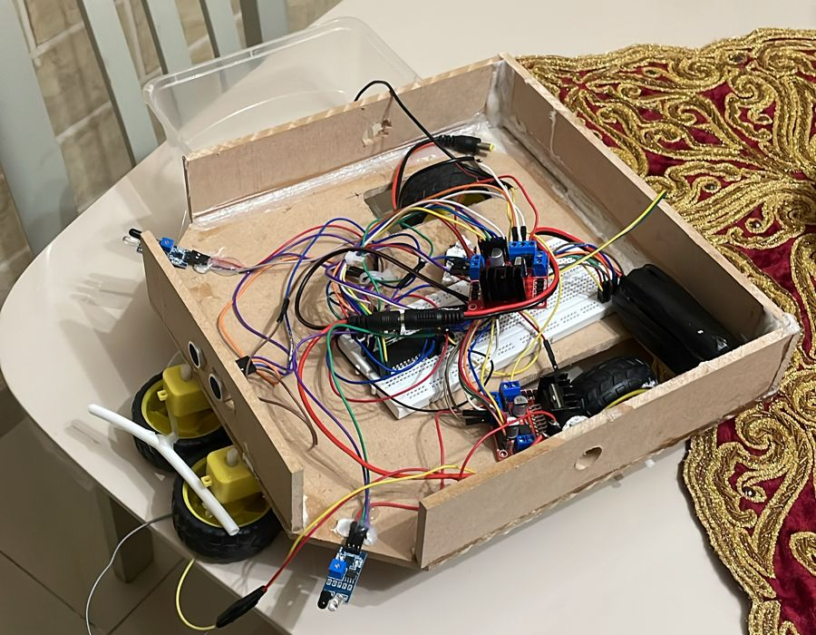
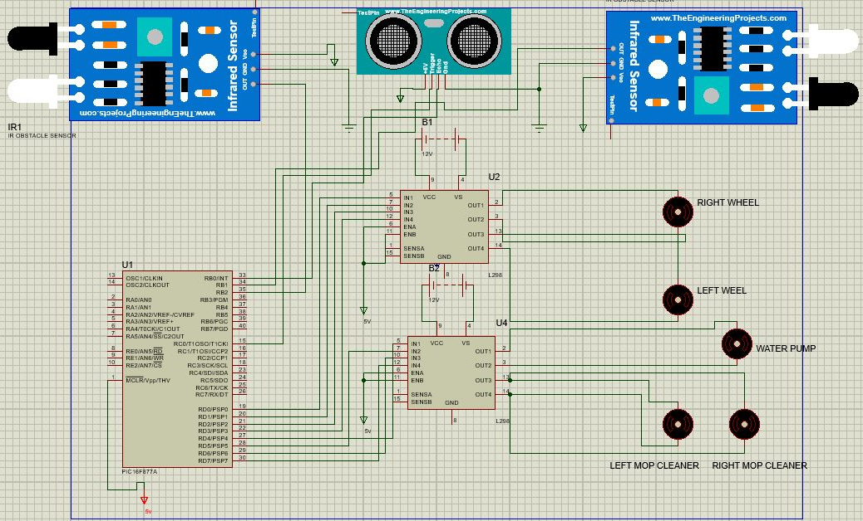
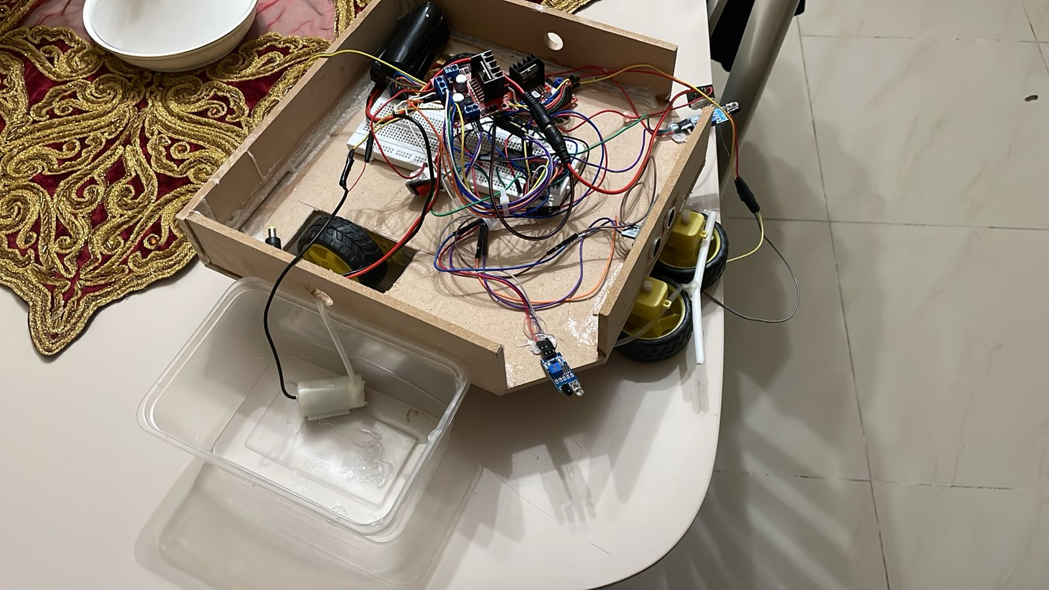
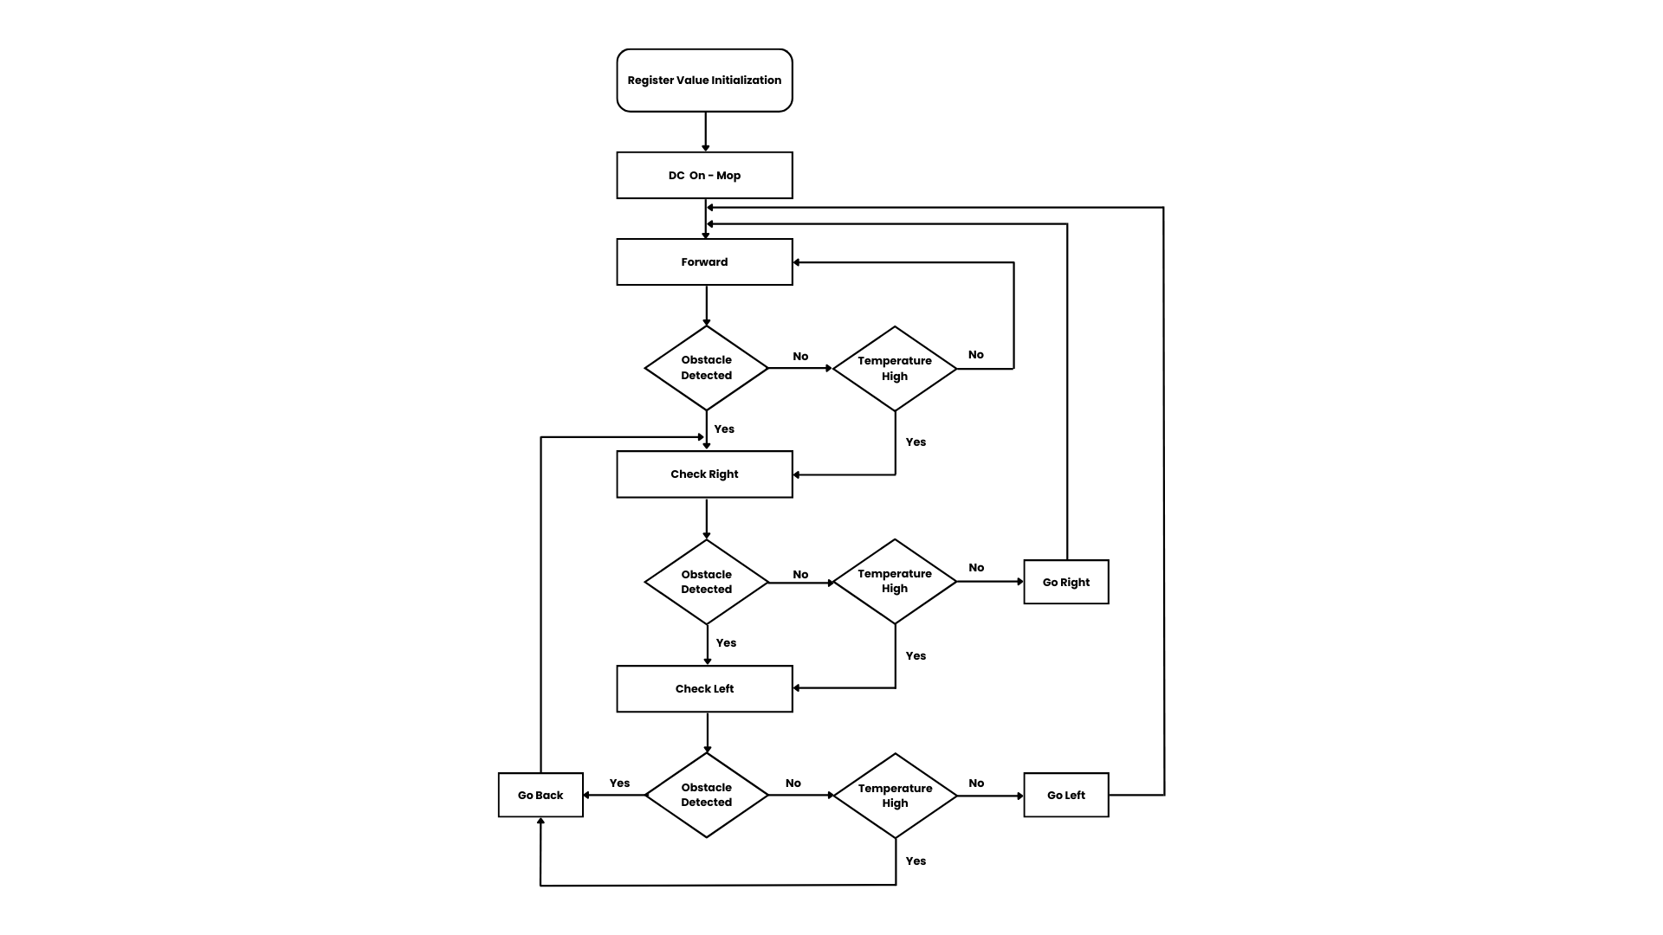
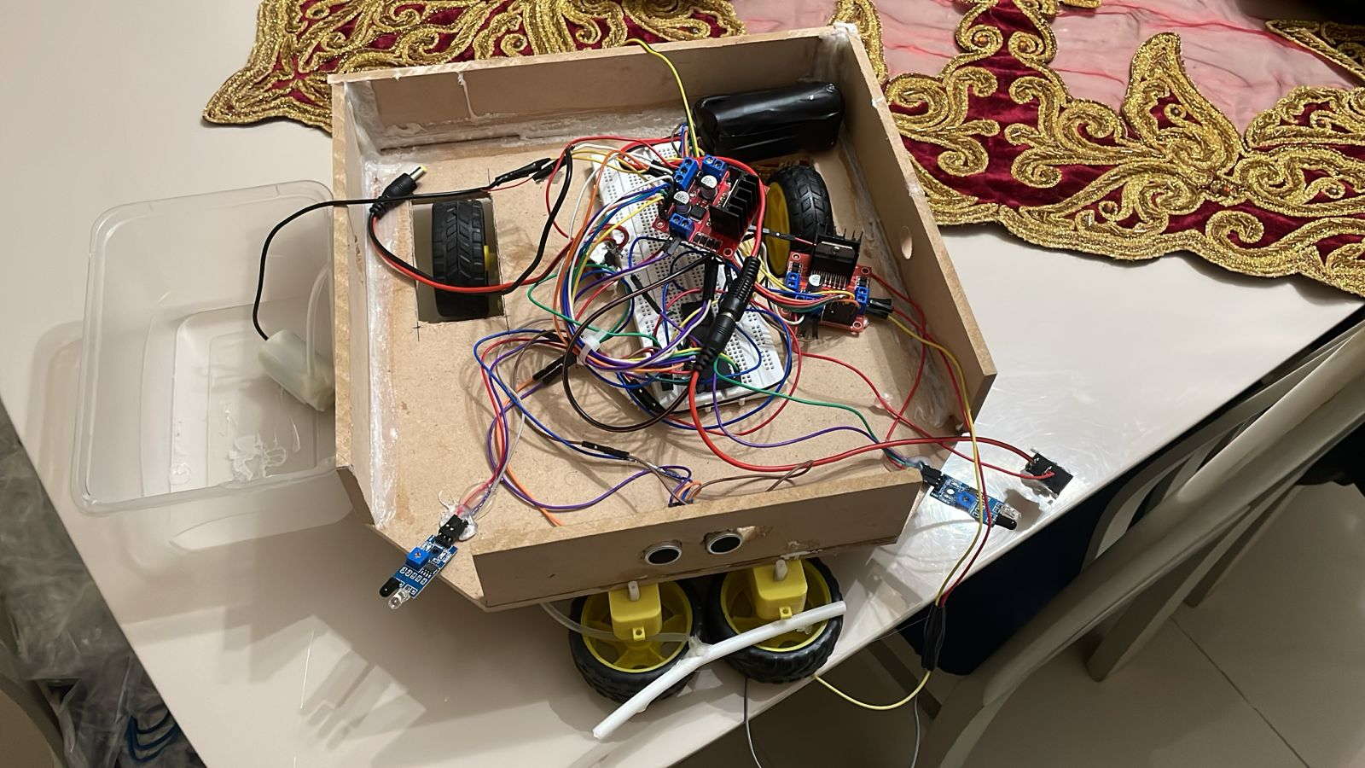
Automated mop cleaner
By: Dunia AlMajali & Ghanem Al-Fawaeer
Supervisor: Dr. Belal Sababha
Embedded Systems Final Design Project
King Abdullah II School of Engineering- Princess Sumaya University for Technology
Introduction
We developed an automated mop cleaner to eliminate the strain of maintaining spotless floors. The mop cleaner has infrared, temperature and ultrasonic navigational sensors. It moves around obstructions with ease, guaranteeing continuous cleaning.
You can also add your own cleaning solution or detergent to the automated mop cleaner.
Our motors operate using two H-Bridges connected to two 12-volt batteries, two infrared sensors, one temperature sensor and one ultrasonic sensor for obstacle avoidance. We also made use of a water pump and tank that may be used to fill with cleaning solution.
Results
With the help of our sensors (ultrasonic, temperature and infrared) we were able to build a mop cleaner that not only cleans and mop floors but can also detect obstacles and avoid them. The user may also choose the detergent or cleaning solution that will be sprayed on the floor by the water pump.
The following figures depict the project's design components.
Figure 1: Upward view of the Mop
Figure 2: Right view of Mop
Figure 3: Front view of Mop
Design
The figures below shows the schematic and the flow chart of the design.
Figure 1: Connected ports with pic 16F877A – Electric Schematic
Figure 2: Software Flow chart
Conclusion
In general, embedded systems are designed and used to make day to day tasks easier to perform, greatly simplifying our lives; the Automated Mop Cleaner is an example of this. It is a technological advancement in floor cleaning. This cutting-edge gadget provides a genuinely customized and effective cleaning experience. It can clean and mop both home and commercial floors, and you may add your own fragrance to the cleaning detergent.
Finally, through our testing and research we were able to create a simple yet fully effective design that makes a daunting task easier. This design can further be advanced with even more specs and newer functionalities.

